Slide 1
ws ch6 - 0
Write a function, circle_area(Radius),which returns the area of a circle of radius Radius. Then use the function to print out a table of radii and corresponding circle areas for the radii 1,3,7,10. Round the circle areas to 3 decimal points.
*********************************************************

Slide 2

WS ch6 -1 use print to debug this code:
WS ch6 -2
The area of a triangle can be found from the formula
A = sqrt(s*(s-a)*(s-b)*(s-c)),
Where a,b,c are the length of the 3 sides of the triangle, and
s = (perimeter)/2
Write a function, triangle_area(x1,y1,x2,y2,x3,y3), Which returns the area of a triangle whose vertices have the coordinates (x1,y1),(x2,y2),(x3,y3). Use appropriate helper functions.
WS ch6 – 3
Write a function, quadratic(a,b,c), which returns the solutions for a quadratic equation,
ax^2 + bx + c = 0. Use conditionals as appropriate. Use your function to print out the solutions for several different quadratic equations:
a,b,c = 1,-1,-2
a,b,c = 1,10,25
a,b,c = 1,-2.5,-6.25
a,b,c = 6,1,-12

Slide 3
ws ch6_4
Write a boolean function, isEven(n), which returns True if n is even and False if n is odd. n is an int.
Write a function, isOdd(n), which returns True if n is odd and False if n is even. n is an int. Use isEven(n) as a helper function.

Slide 4
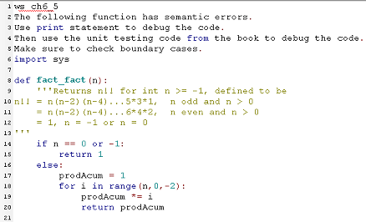

Slide 5
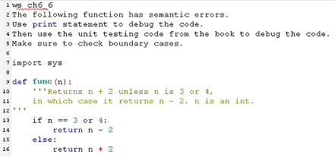

Slide 6
ws ch6_7
Write a boolean function, isFactor(f,n), which returns True
if f is a factor of n, OTW it returns False.
Use this function to print out all factors of 60 which are
greater than 1 and smaller than n.

Slide 7
ws ch6_8
Write a function, listOfFactorsOf(n), which returns a list of the factors of int n, n >= 2 and where the factors are larger than or equal to 2 and smaller than n. Uses isFactor(f,n) as a helper function. Use your function to print a table of ints from 2 to 20 with their factors

Slide 8
ws ch6_9
Write a function, isPrime(n),
which returns True if n is prime,
OTW it returns False.
Use your function to print out all primes <= 1000, 15 primes per line.
Use listOfFactorsOf(n) and isFactor(f,n) as helper functions
Write a function, tableOfPrimes(From,To,num_per_line),
Which prints out the prime numbers from From to To,
With num_per_line primes per line.

Slide 9
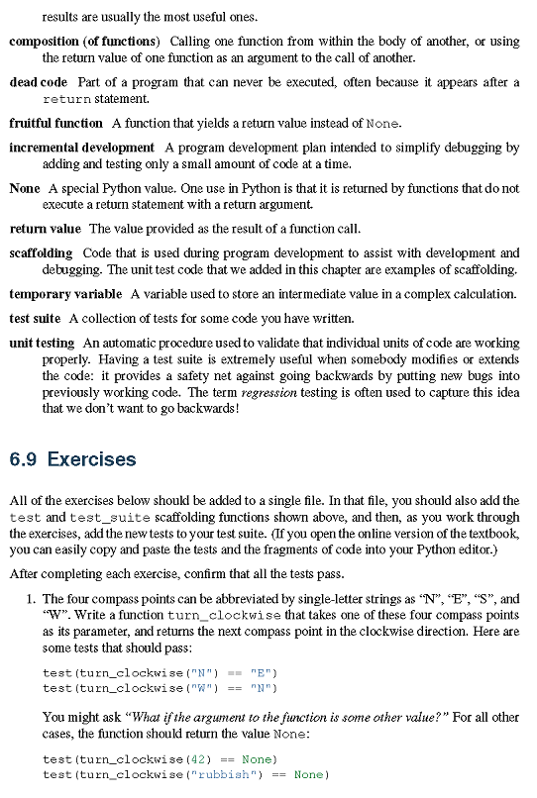

Slide 10
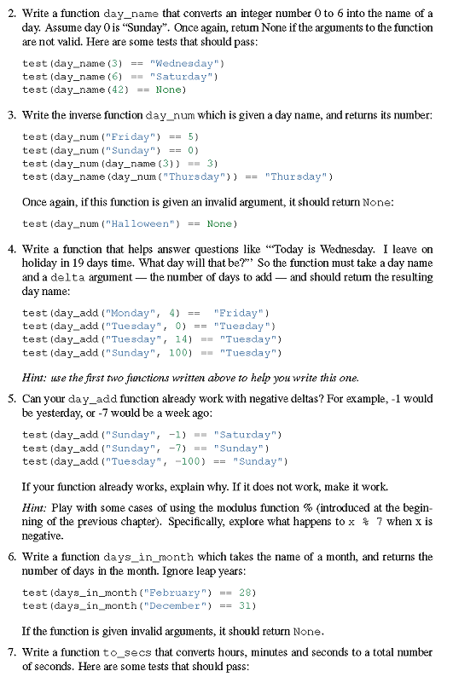

Slide 11
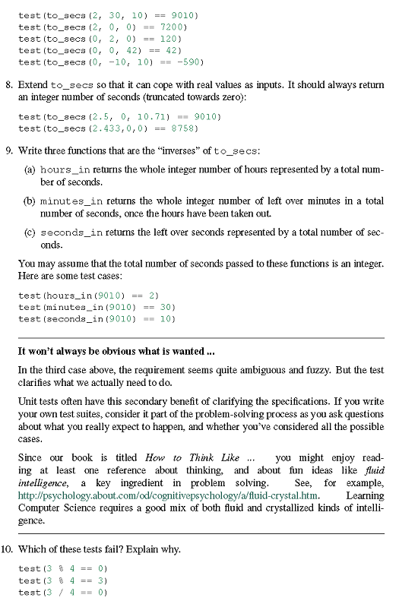

Slide 12
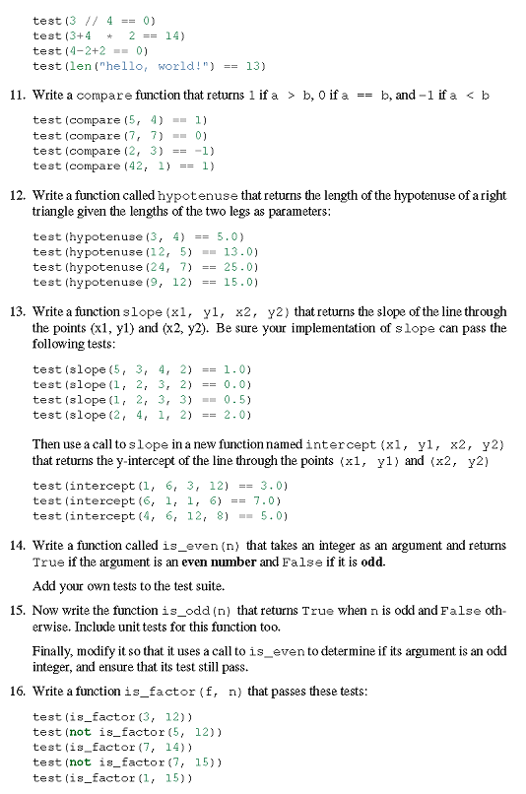

Slide 13
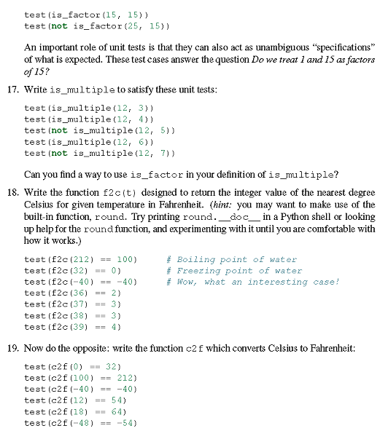

Slide 14
HW:1,2,3,4,7,16
Youtube: 13

